Slide 1
DISASTER RECOVERY MECHANISM WITH ACTIVE STORAGE REPLICATION AND DNS FAILOVER IN CLOUD VIRTUAL MACHINE
Kolla Priya(211418104129)
Kuricheti Spoorthi(211418104136)
Balasa Chenchu Sai Vyshnavi(211418104036)
GUIDED BY
Mrs.R.DEVI,M.E.,
ASSISTANT PROFESSOR DEPARTMENT OF CSE PANIMALAR ENGINEERING COLLEGE CHENNAI

Slide 2
PROBLEM STATEMENT
To ensure continuous performance and minimize service downtime, services can be switched from the active server of a high-availability cluster to the redundant, passive server.
This feature is known as "Switch-over" or "Failover" in some circumstances.
During this period there are huge chances for an organization to be a victim of huge, valuable data loss and have a downtime for a certain period.

Slide 3
DEVELOPMENT ENVIRONMENT
HARDWARE ENVIRONMENT:
● Processor : core i5/17/i8 ● RAM : 4GB ● CPU : 2 x 64-bit 2.8GHZ 8.00 GT/s ● Disk storage : 500 GB. ● NAS based Virtual Storage Disk (AZURE)
SOFTWARE ENVIRONMENT:
● Operating system : Windows 7/8/10(64bit) / Unix/ Linux ● Additional : ● Azure VM ● Shell Scripting ● Django ● Python ● Postgresql
● Server go-live providers (Apache KNOX, Nginx, Gunicorn)

Slide 4
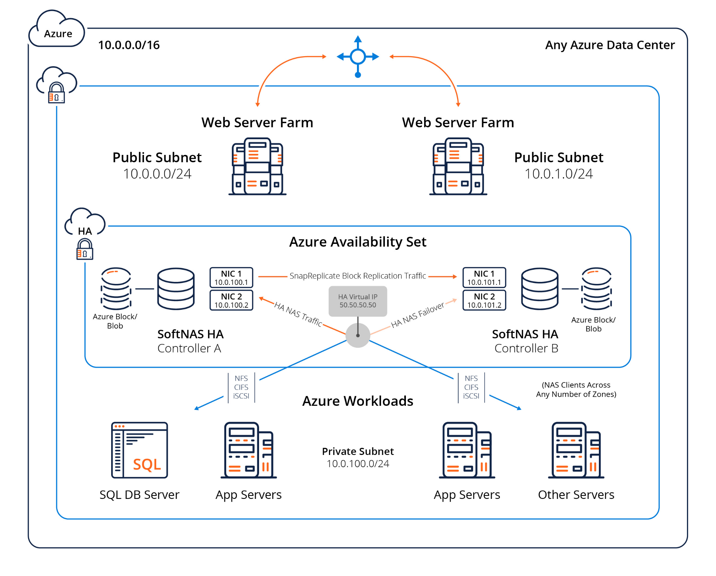
SYSTEM ARCHITECTURE

Slide 5
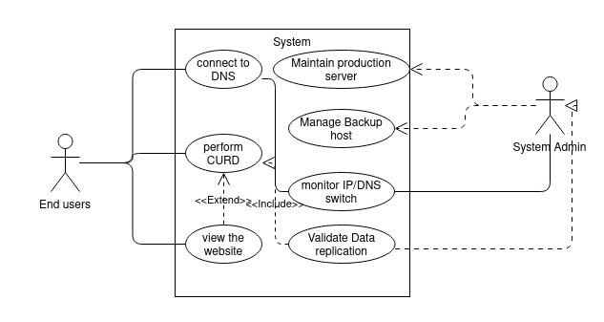
SYSTEM DESIGN
USECASE DIAGRAM

Slide 6
INTRODUCTION
The Domain Name System (DNS) is a vital service in the Internet. Much more than a simple translation mechanism, it also allows higher profile functionalities such as load balancing and enhanced content distribution.
In the scope of cloud computing, DNS is foreseen as an elastic and robust service, supporting failover mechanisms, decentralised configuration and multi-tenant isolation.
The problem arises where a particular DNS is not able to point an IP address of the server because of heavy traffic, DDoS attack, system crash and much more reasons.
During this period there are huge chances for an organization to be a victim of huge, valuable data loss and have a downtime for a certain period.
This will cause a billion dollar business impact and risk of losing data.
To overcome this we come up with an approach of DNS Failover with active Replication which is a solution designed to help keep the services online and prevent from Data losses.
When systems and services go down DNS failover is used to direct the users to another resource with little to no disruption which has active replication of Data with the current prod Server.
The backup server/ Replicating server is named as Contingency server (CNR) which has a active storage replication with the Production server preventing Data loss.

Slide 7
LITERATURE SURVEY
Author | Methodology | Major findings
S. N. John and T. T. Mirnalinee(2019) | RSPC | It demonstrates a popularity based file selection strategy through analyzing data access by users in a determined period of time.
N. Mansouri, M. M. Javidi and B. M. H. Zade,(2021) | SDR,HDRS | Identifies popular files as replication candidates based on the number of file-access times, where the higher the number of file-access times, the higher the popularity.
Yanling Shao, Chunlin Li, Zhao Fu, Jia Leyue and Luo Youlong(2019) | DRSA and DRCA | This provides better system performance and search the higher quality replica placement solution while reducing the total data access costs under the deadline constraint.
Xiong Fu, Jian Li, Wenjie Liu, Song Deng and Junchang Wang(2019) | RPBLB | RPBLB suggested duplicating the most used data to new storage without neglecting the storage load balancing.
A. U. Rehman, R. L. Aguiar and J. P. Barraca | SDN fault tolerance | in his work, addressed the Software Defined Networking (SDN) fault-tolerance and discussed the OpenFlow fault-tolerance support for failure recovery
S. Zheng, M. Hoseinzadeh, and S. Swanson,(2019) | NVMM | They proposed Emerging fast, byte-addressable Non-Volatile Main Memory (NVMM) that provides huge increases in storage performance compared to traditional disks.
V. Bindhu,(2020) | Zero downtime deployment | Proposed zero-downtime deployment, would ideally not cause any outage to the end users. The old version continues to run till the new version is ready.

Slide 8
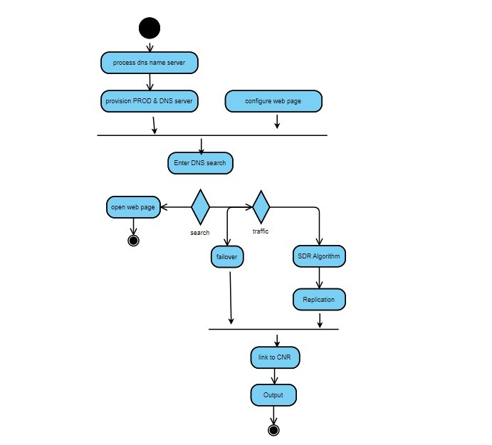
ACTIVITY DIAGRAM

Slide 9
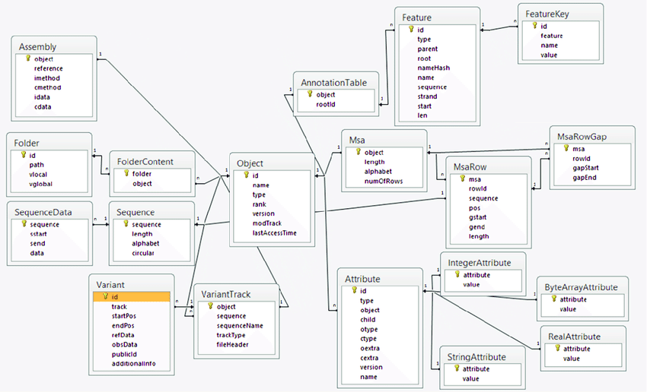
ER DIAGRAM

Slide 10
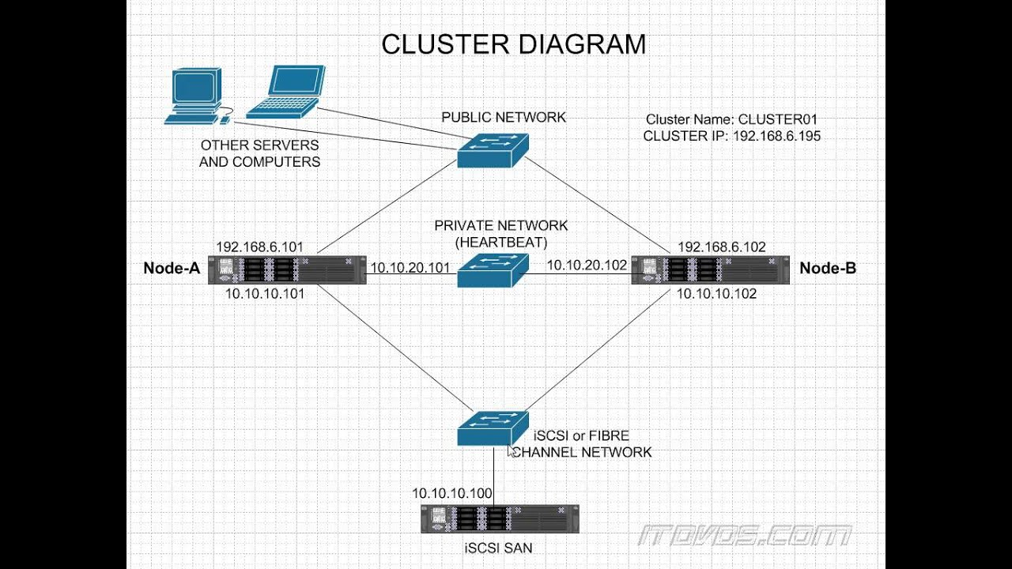
USER INTERFACE DIAGRAM

Slide 11
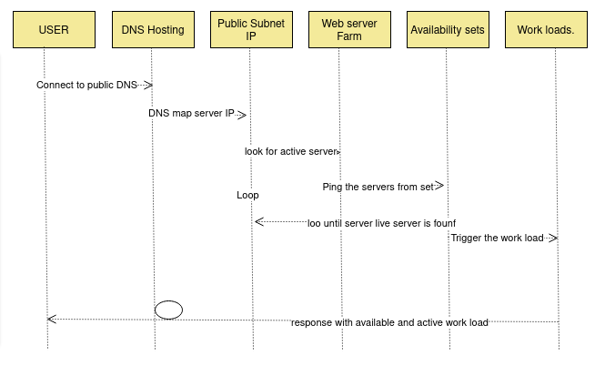
SEQUENCE DIAGRAM

Slide 12
MODULE DESCRIPTION
Resource group creation
Configure Test Web page
Test and setup failover and replication

Slide 13
RESOURCE GROUP CREATION
In the Azure portal, to form any resource, be it a VM, Disk, or Storage Account, the Azure Resource Group, is mandatory. Every Resource/Instance created are going be linked to a Resource Group. Thus, an Azure AD (Active Directory) group is created as they are Security Principals, which means they can be used to secure objects in Azure AD.
Process the DNS Name Server as it is the server that stores all DNS records for a domain, which includes A records, MX records, CNAME records. Almost every domain rely on multiple name servers to increase reliability: if one name server goes down or if at all its unavailable then the DNS queries can go to another one.
Provision of PRODUCTION and BACKUP Server takes place. In this process a backup repository server is created in the cloud. This is where the protected data from your active source is stored.

Slide 14
CONFIGURE TEST WEB PAGE
Scripting a Django based website to test the activeness of the server takes place here, as Django is a fully featured server-side web framework, which is written in pythonThis module shows you how to set up a particular development environment, and how to start using it to create your own specific web applications.
Domain name is purchased in GoDaddy as its used as a webhost and domain registrar and it supports websites and applications built using Django.However the company recommends choosing a VPS hosting plan or a dedicated server plan for the apps, once we choose a hosting plan, we can use the cPanel control panel to install python and Django, after the purchase of domain name we can host our website with the service.
Configure Apache knox for DNS failover, Knox provides connectivity-based failover functionality for service calls that can be made to more than one server instance in a cluster. Ha Provider configuration needs to be enabled for the service to enable this functionality and also the service itself must be configured with more than one URL in the topology file.

Slide 15
TEST AND SETUP FAILOVER AND REPLICATION
Host server using Nginx and Gunicorn. Nginx is a very powerful web server. A ton of things can be done using it, such as setting up reverse proxies or load balancing. It can also be used to host the static website, Gunicorn is used to pass request data to your application ,and to receive response data , it takes care of running multiple instances of web application, making sure they are healthy and restart them as needed , distributing incoming requests across those instances and communicate with the web server.
Multi-datacenter are designed to load balance the processing of data in multiple cluster, and also to safeguard against outages by replicating data across the clusters. If at all a particular datacenter goes down, the remaining datacenters have replicas of the data and can take over where the failed datacenter left off. Once the original datacenter recovers, it then resumes message processing. Replicator knows where to re-start data synchronization across clusters based on these supporting features for failover and disaster recovery. In case of failover from the production server to the CNR server, the consumers will start consuming data from the last committed offset

Slide 16
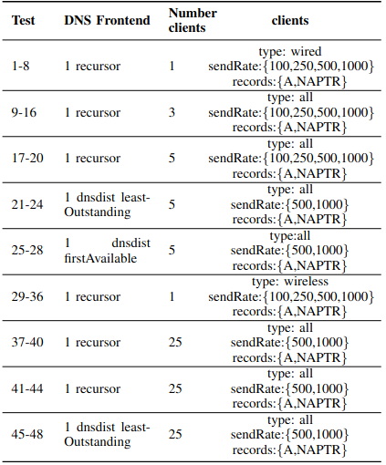
PERFORMANCE ANALYSIS

Slide 17
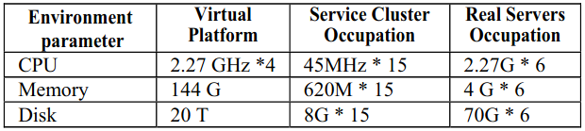
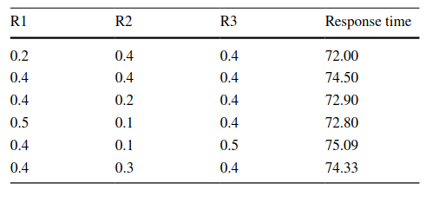

Slide 18
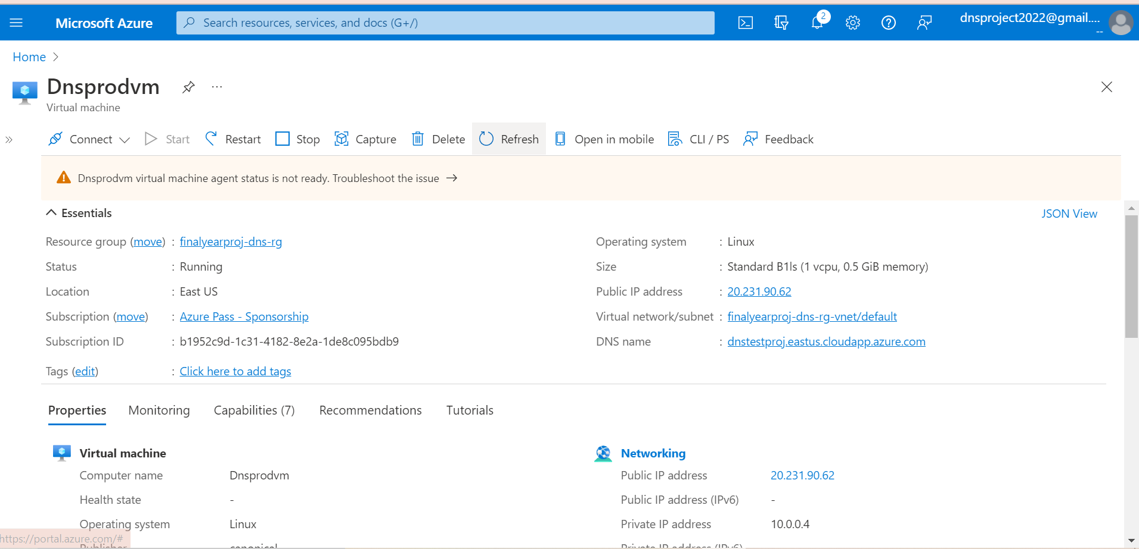
SCREEN SHOTS
DNS Production Server VM

Slide 19
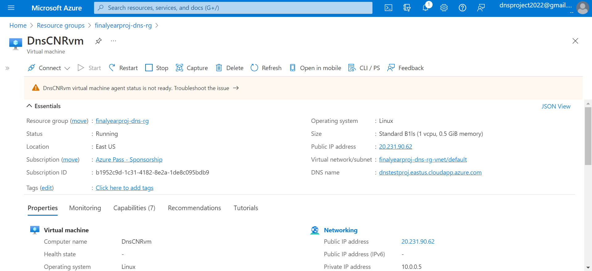
DNS Contingency Server VM

Slide 20
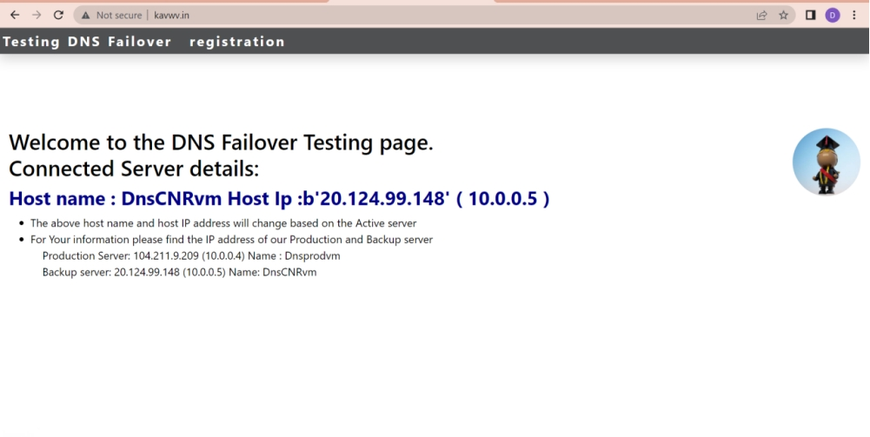
DNS Failover Testing page

Slide 21
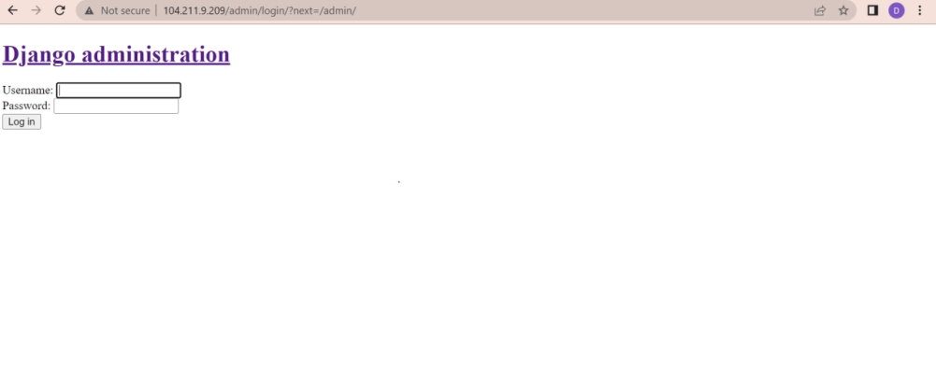
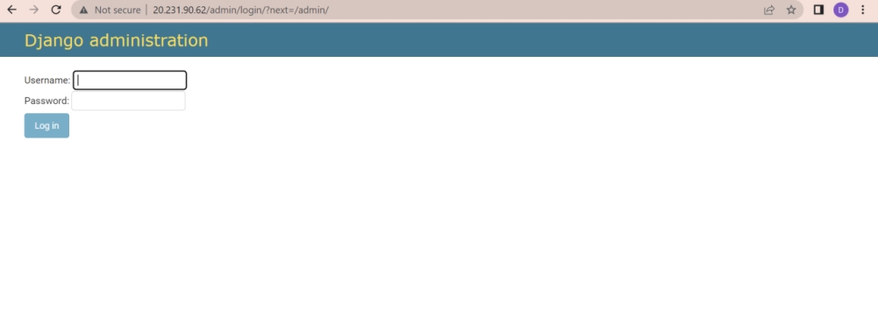
Production Server login page
Contingency Server admin page

Slide 22
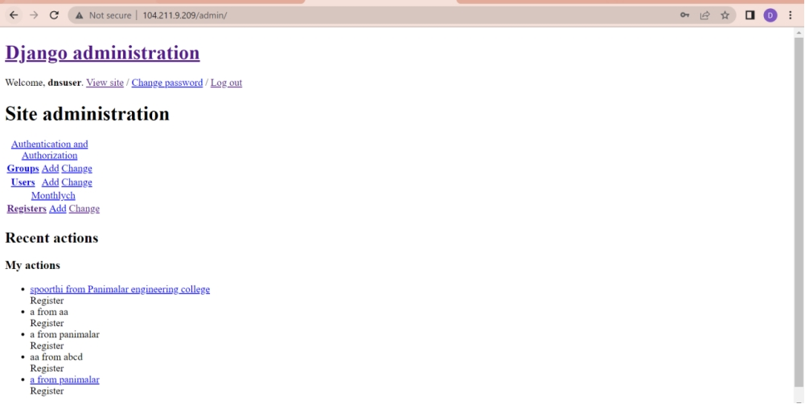
Django Adminstration page

Slide 23
CONCLUSION
An elastic and scalable architecture for DNS as a Service, suitable for cloud-based platforms, was presented and validated. The provided assessment, obtained through experimentation, demonstrated the employed scaling practices for cloud-based services. The obtained results further proved the proposed architecture’s elasticity and flexibility, which takes into account the specificities of the DNS service while not being tied to a particular cloud-computing platform. Regarding the performance evaluation of the presented architecture, it became clear that the service is able to accommodate variable loads of DNS queries per second, always keeping satisfactory levels of performance in terms of DNS queries throughput and low latency DNS answers. This performance level was maintained by DNSaaS resorting to a horizontal scaling approach, instantiating additional resources whenever required. The DNS Service Cluster has a greater number of SQRs and reduces failover time by 94% compared to the Real Servers.
Future Enhancements: The future scope of DNS and Store failover and replication involves addressing the following key areas: 1. Increase Replication rate in Cluster based environment. Overcome lag of 6% in DNS failover which can be high in fast paced cluster regions.

Slide 24
REFERENCES
[1]S. N. John and T. T. Mirnalinee, “A novel dynamic data replication strategy to improve access efficiency of cloud storage,” Information Systems and e-Business Management , vol. 18, pp. 405-426, July. 2019.
[2]N. Mansouri, M. M. Javidi and B. M. H. Zade, “A CSO-based approach for secure data replication in cloud computing environment,” The Journal of Supercomputing, vol 77, pp. 5882-5933, 2021.
[3]N. Mansouri, M. M. Javidi and B. M. H. Zade, “Hierarchical data replication strategy to improve performance in cloud computing,” Frontiers of Computer Science, vol 15, Article 152501, 2021.
[4]Yanling Shao, Chunlin Li, Zhao Fu, Jia Leyue and Luo Youlong, “Cost-effective replication management and scheduling in edge computing,” Journal of Network and Computer Applications, vol 129, pp. 46-61, March. 2019.
[5]Xiong Fu, Jian Li, Wenjie Liu, Song Deng and Junchang Wang, “Data replica placement policy based on load balance in cloud storage system,” IEEE 3rd Information Technology, Networking, Electronic and Automation Control Conference (ITNEC 2019).
[6]A. U. Rehman, R. L. Aguiar and J. P. Barraca, “ Fault-Tolerance in the Scope of Software-Defined Networking (SDN),” IEEE Access, Vol 7., to be published.

Slide 25
[7]S. Zheng, M. Hoseinzadeh, and S. Swanson, “Ziggurat: A tiered file system for non-volatile main memories and disks,” in Proc. FAST’19, Boston, MA, USA, February 25–28, 2019.
[8]V. Bindhu, “Constraints Mitigation in Cognitive Radio Networks Using Cloud Computing,” Journal of trends in Computer Science and Smart technology, vol 2,pp. 1-14, 2020.
[9]Ernesto Garbarino, “Beginning Kubernetes on the Google Cloud Platform: A Guide to Automating Application Deployment, Scaling, and Management,” pp. 129-154, 2019.
[10] Jayashree Mohan, Amar Phanishayee, Vijay Chidambaram, “CheckFreq: Frequent, Fine-Grained DNN Checkpointing,” in Proc. 19th USENIX Conference on File and Storage Technologies, February 23–25, 2021.
[11] L. Y. Chen, W.M. Li, and Z. M. Lei, “Alleviating the Impact of DNS DDoS Attacks,” Networks Security, Wireless Communications and Trusted Computing, International Conference, Apr. 2010, pp. 240- 243.
[12]A. J. Kalafut, C. A. Cole, C. Lei, M. Gupta, and N. E. Myers, “An empirical study of orphan DNS servers in the internet,” In IMC '10: Proceedings of the 10th annual conference on Internet measurement, Melbourne, Nov. 2010, pp. 308-314.
[13]P. Vixie, “DNS Complexity,” ACM Queue vol. 5, no. 3,Apr. 2007.
[14]D. Wessels, "A Recent DNS Survey," DNS-OARC,Nov. 2007.

